Slide 1
Group 3 – FCEPH
Team Project
Anis Subba - Jennifer Odongo - Benjamin Mapamboli - Nazir Mohammmad
https://github.com/AKLBeast/AKLbeast-

Slide 2

FCEPH | Introduction

Slide 3
FCEPH | Recap
FCEPH is a supermarket that sells Food, Clothes, Electronics, Health & beauty and Household products.
We chose the name FCEPH because it stands for Food, Clothing, Electronics, Pharmacy and Household.
What did we do
We created a website for our project.

Slide 4
FCEPH | Anis
Project Manager
Meeting Minute Documentation
Project Planning with the team
Suppliers Interface
User should be able to view stock amount. REMOVED
There should be a list of suppliers with their details.
User should be able to select a supplier.
User should be able to select type of product from supplier.
User should be able to place order with supplier.
Stock should be updated. REMOVED

Slide 5
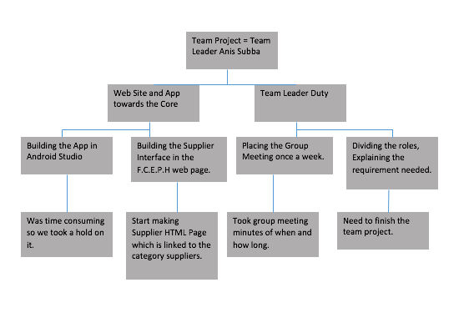
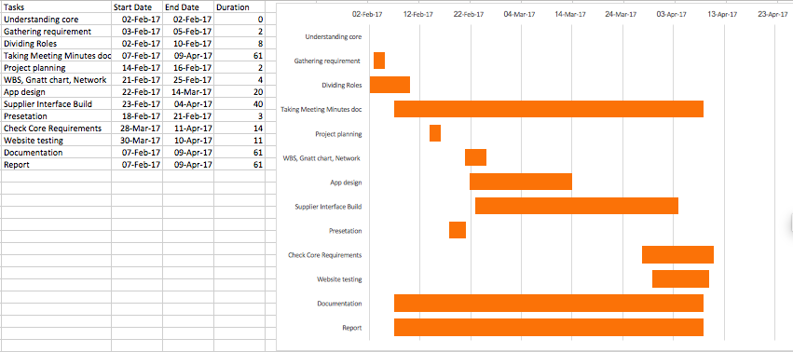
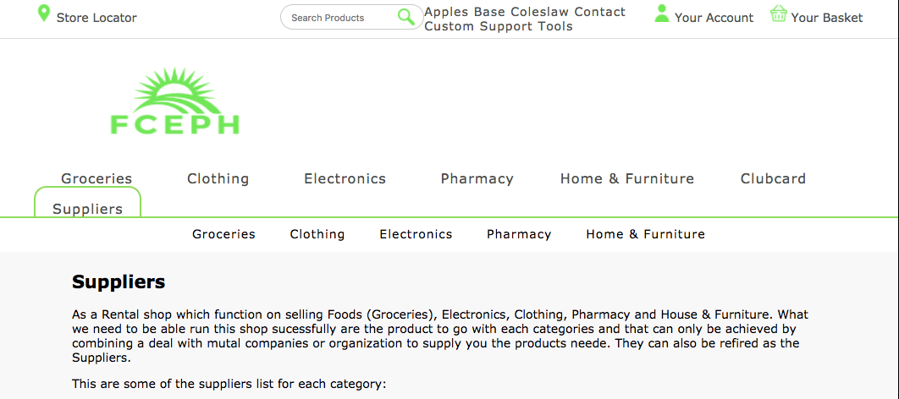
FCEPH | Anis – Project Plan
WBS: It tell you what divides my roles and duties in the whole project.
Gantt Chart showing you how much time it took me to finish certain aspect of the projects.
This is a preview of my Supplier Page.
Risk Registry : Show you some of the Positive Risk and Negative Risk developed in the project.

Slide 6
FCEPH | Jennifer
Documentation
Documenting the project
Chart
Loyalty Scheme
A customer should be able to register to a loyalty company.
A customer should be assigned a loyalty card - removed
Points should be added - Implied
Points should be removed - removed
Receive special deals for loyalty points and discounts.

Slide 7
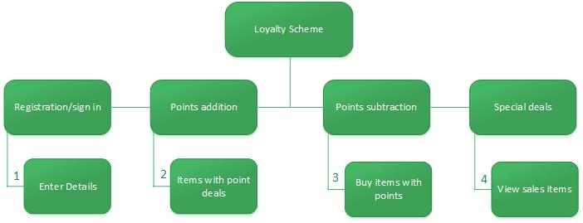
FCEPH | Jennifer – Project Plan
Work breakdown Structure
Breakdown workload
Project seem more manageable
Risk register
Negative Risks
Positive Risks
No. | Rank | Risk | Description | Category | Root | Triggers | Potential Responses | Risk Owner | Status
R1 | 1 | Incompletion | Not finishing the sub component on time | Negative | Started component late because core was unfinished | Passing deadlines set for tasks | Spend more time on component | Jennifer, Ben | Risk avoided
R4 | 2 | Extra time | Finishing things on time/early | Positive | Spending more time on the component | Finishing the component early | Spend more time on component | Jennifer | Risk avoided

Slide 8
FCEPH | Nazir
Integration
I created an integration plan for everyone's component.
Joining components into the core.
Payment
Used paper-input and paper- button polymer components
Include customer account details
Confirm –Cancel buttons
Style CSS

Slide 9
FCEPH | Nazir – Project Plan
Risk Register
Positive –Negative Risks within the project.
Payment Requirement
A customer should receive payment request when attempting to check out.
Customer should receive a confirmation or denial for their payment.
Software
Note++, NetBeans and Bracket.
Component Integration
Checkout Payment Client Info Confirm Payment Cancel Payment

Slide 10
FCEPH | Benjamin
Quality Assurance
Checking the quality of work produced by the team
Risk Register
Marketing
User should be able to view the types of items purchased by a customer.
User should be able to send recommendations/deals to customers.

Slide 11
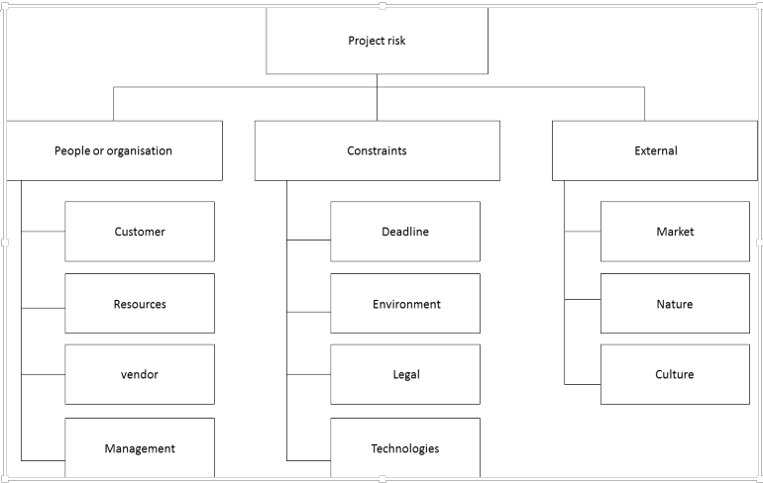
FCEPH | Benjamin – Project Plan
Risk Breakdown Structure

Slide 12
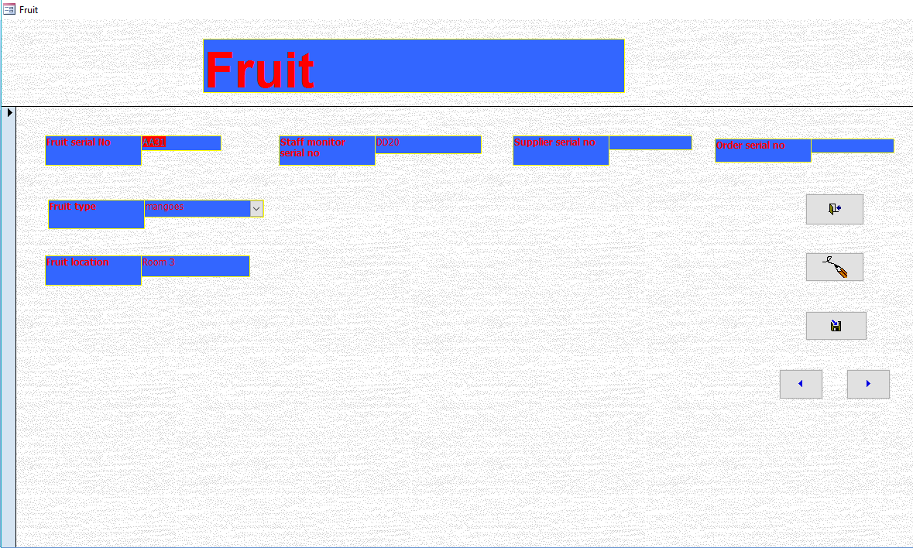
Component
Database Form

Slide 13
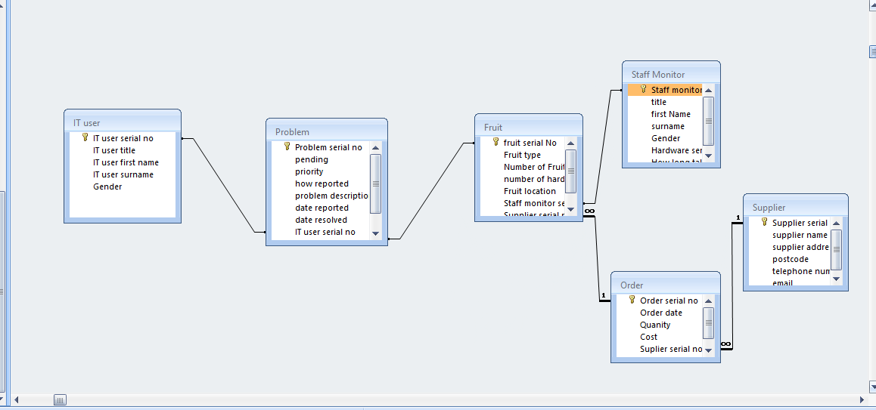
FCEPH relationship

Slide 14
Any Questions?

